Slide 1
Medimate -Making Healthcare Support Easy, One Chat At A Time
PIP2001 Capstone Project
FINAL REVIEW
Batch Number: IST-02
Roll number | Student Name
20211IST0002 | Sugunashree M K
20211IST0003 | Huzaifa Shariff
20211IST0014 | Shruti Kumari
20211IST0013 | Tamanpreet Kaur
Under the Supervision of,
Mrs. Monisha Gupta
Professor
School of Computer Science and Engineering
Presidency University
Name of the Program: Information Science and Technology
Name of the HoD: Dr. Pallavi R
Name of the Program Project Coordinator: Prof. Srinivas Mishra
Name of the School Project Coordinators: Dr. Sampath A K / Dr. Abdul Khadar A / Mr. Md Ziaur Rahman

Slide 2
Introduction
Medimate is an AI-powered healthcare chatbot designed to provide instant and accurate support for medical queries, available 24/7 to assist users anytime, even in emergencies.
It helps analyze symptoms to suggest possible conditions, guides users on the next steps, and streamlines appointment management with booking and reminder features.
Medimate also offers personalized health tips, tracks prescriptions, and ensures medication adherence through timely reminders.
With robust data security and confidentiality measures, it empowers users with reliable healthcare guidance while safeguarding their privacy.

Slide 3
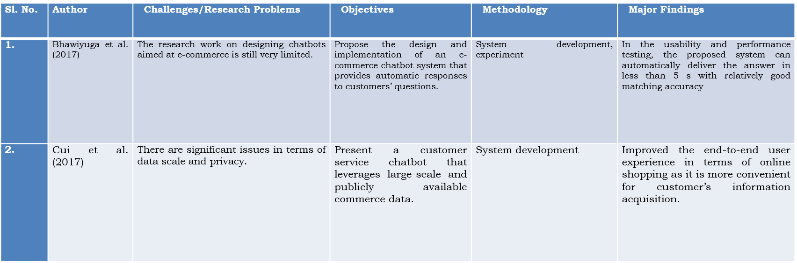
Literature Review

Slide 4
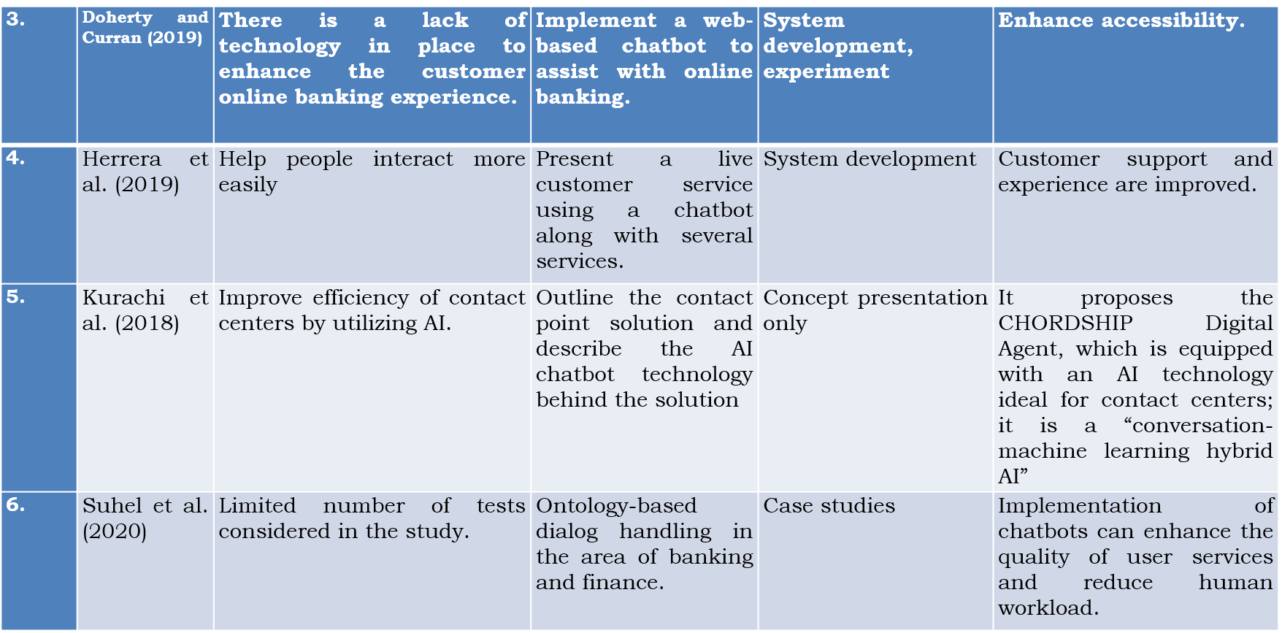
Literature Review

Slide 5
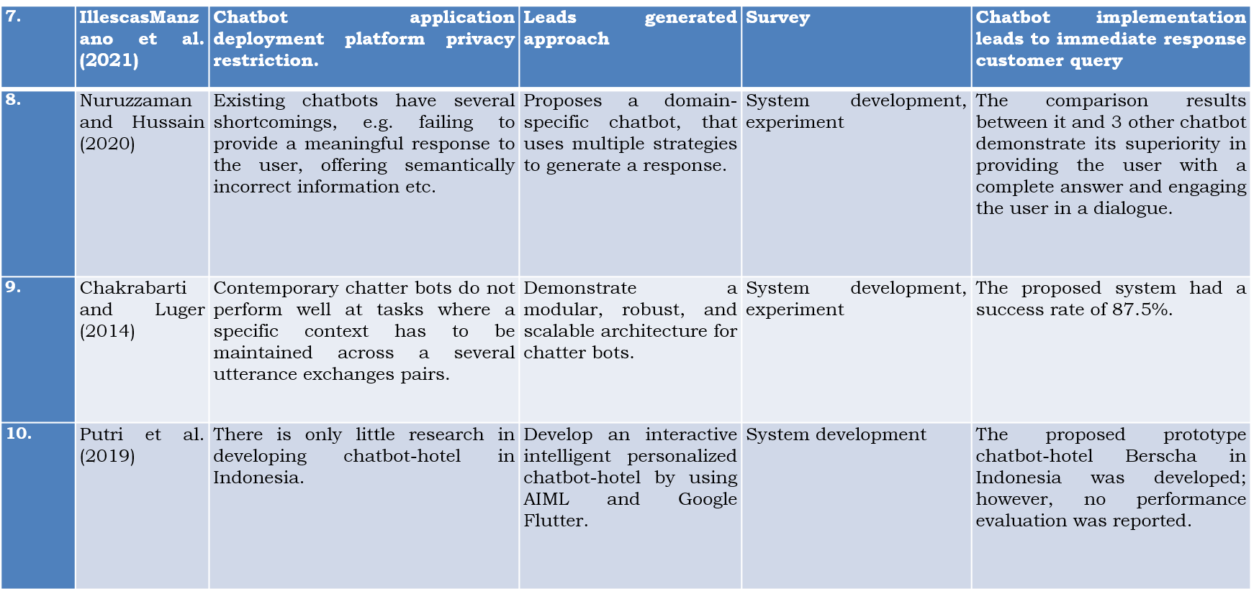
Literature Review

Slide 6
Research Gaps Identified
Limited Accuracy in Complex Diagnoses
Integration with Healthcare Systems
Handling Emergency Scenarios
Scalability and Emotional Intelligence
Health Inequalities

Slide 7
Proposed Method
Define Objectives and Scope
Data Collection and Preparation
Model Selection and Training
i. Natural Language Processing (NLP)
ii. Machine Learning Approaches
Integration with Platforms
Testing and Iteration
Deployment and Monitoring

Slide 8
Objectives
Provide Accessible Healthcare Support: Deliver 24/7 assistance to users for medical queries and concerns.
Enhance User Convenience: Simplify appointment scheduling, symptom analysis, and medication management.
Promote Preventive Care: Offer personalized health tips and reminders to encourage healthy lifestyles.
Ensure Data Privacy: Maintain user trust by adhering to strict data protection and privacy standards.
Improve Healthcare Efficiency: Reduce the burden on healthcare providers by automating routine tasks.

Slide 9
System Design & Implementation
MediMate project already incorporates a robust set of tools and technologies Here's a summary of what's been used:
Model: Pickle Programming Languages: Python, JavaScript, HTML, CSS Frameworks: Flask Data Formats and Libraries: JSON, Pickle, NumPy, Pandas Datasets: Kaggle datasets AI/ML Tools: GPT-4

Slide 10
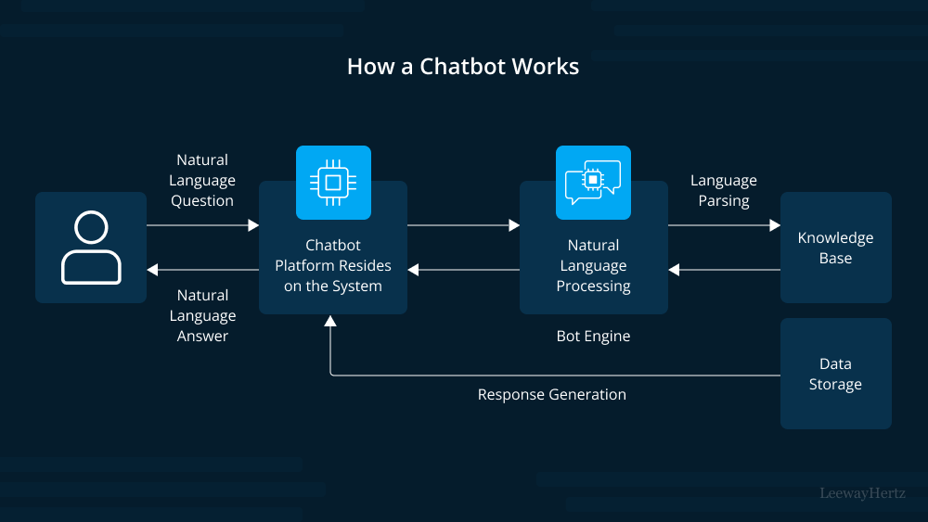
Architecture

Slide 11
Software components
Frontend: HTML5,CSS3, JavaScript
Backend: Flask
Python: (NLTK)
Database: Dataset is stored
Machine Learning/NLP: TensorFlow

Slide 12
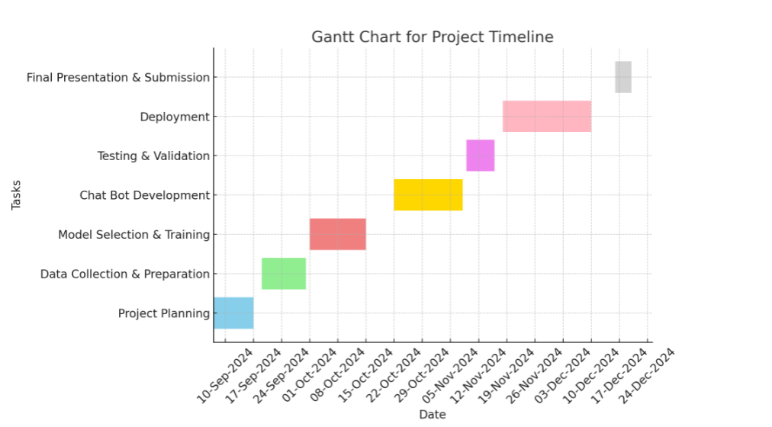
Timeline of Project
Fig 7.1 Gantt Chart

Slide 13
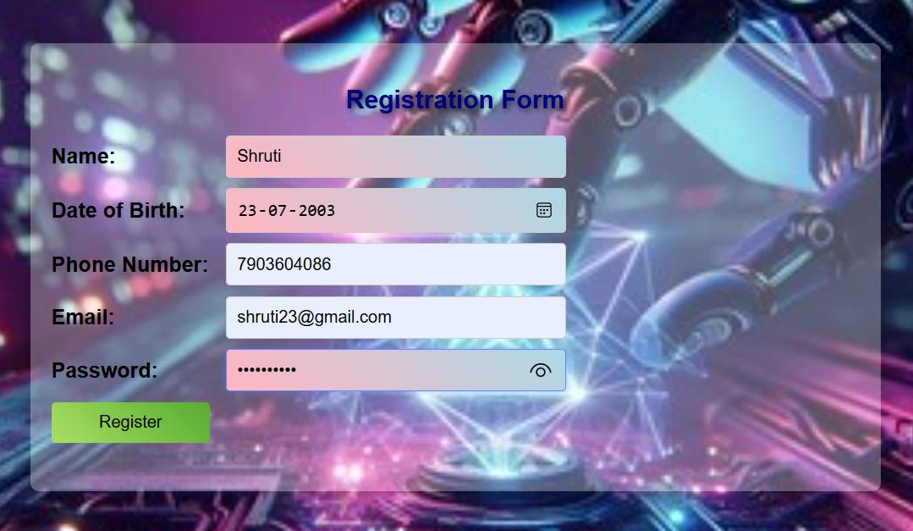
Project’s Results
Fig A2.1 Registration Page

Slide 14
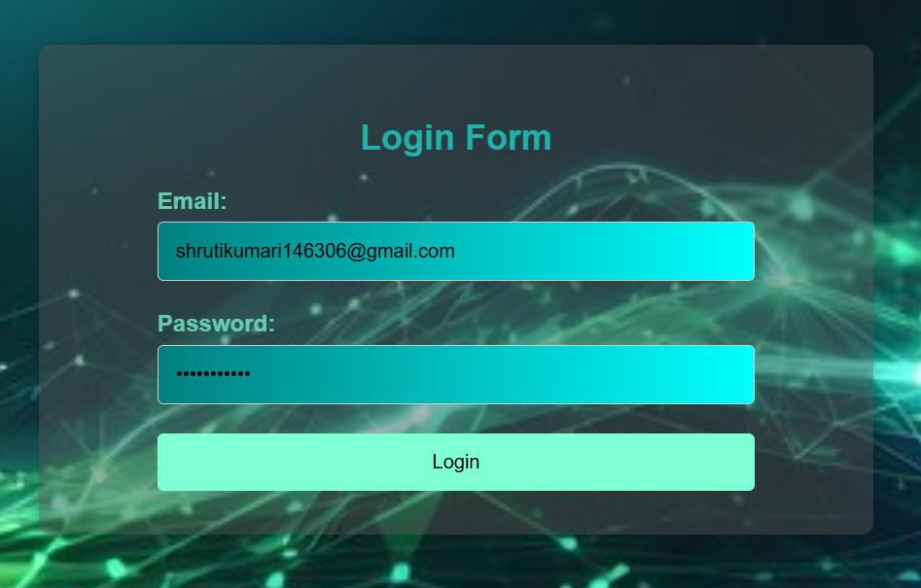
Fig A2.2 Login Page

Slide 15
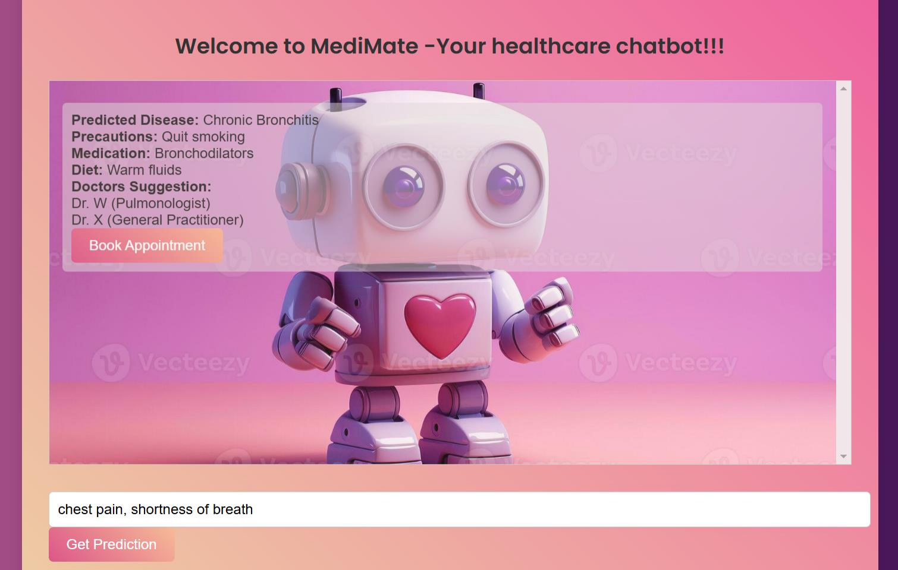
Fig A2.3 Chatbox page

Slide 16
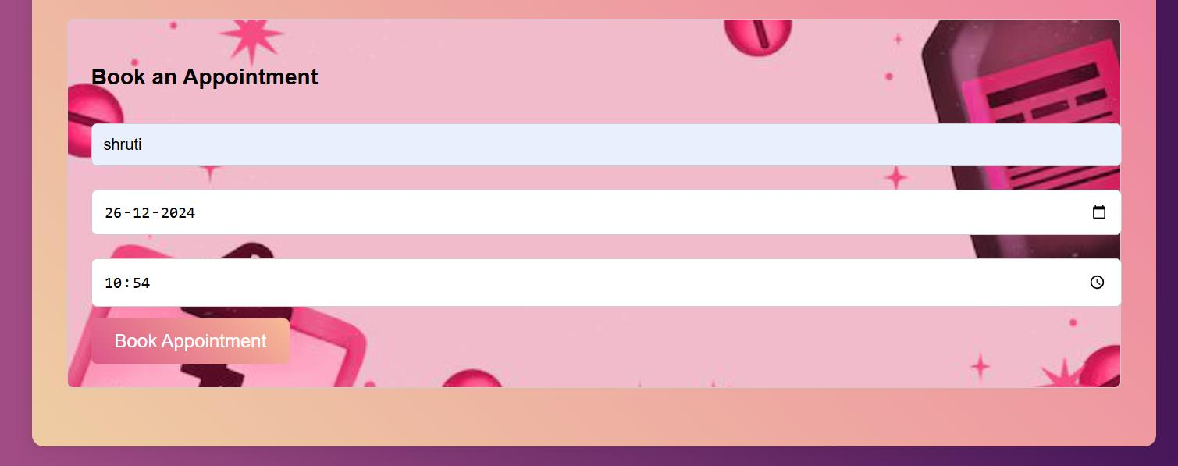
Fig A2.5 Appointment booking

Slide 17
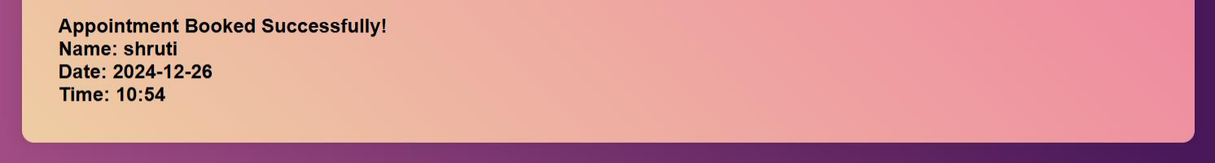
Fig A2.6 Successful appointment booking message

Slide 18
Outcomes
Easy Access: Simplifies healthcare support via a chat interface.
Seamless Communication: Connects patients and providers efficiently.
Personalized Assistance: Offers tailored health advice and reminders.
Better Health Outcomes: Promotes early diagnosis and proactive care.
Efficiency: Automates routine tasks, saving time for providers.
User Empowerment: Enhances health literacy and informed decision-making.
Global Reach: Provides support in remote or underserved areas.
Data Insights: Generates trends for better healthcare strategies.
Mental Health Support: Offers a safe space for mental well-being.
Continuous Improvement: Adapts to the latest medical knowledge.

Slide 19
Conclusion
Medimate is a transformative healthcare chatbot designed to bridge the gap between patients and healthcare providers.
By offering 24/7 support, personalized health guidance, and streamlined management of appointments and medications, it enhances user convenience and promotes preventive care.
With a strong focus on data privacy and inclusivity, Medimate empowers individuals to make informed health decisions while easing the burden on healthcare systems.
As a reliable and accessible tool, Medimate represents a step forward in making quality healthcare more efficient, user-friendly, and universally available.

Slide 20
References
[1] Prof.K. Bala, Mukesh Kumar, Sayali Hulawale and SahiI Pandita, "Chat-Bot For College Management System Using A.I", International Research Journal of Engineering and Technology (IRJET), vol. 04, no. 11, pp. 2030-2033, Nov 2017.
[2] Guruswami Hiremath, Aishwarya Hajare, Priyanka Bhosale, Rasika Nanaware and K. S. Wagh, "Chatbot for education system", International Journal of Advance Research Ideas and Innovations in Technology (IJARIIT), vol. 4, no. 3, pp. 37-43, 2018.
[3] K. Jwala, G.N.V.G Sirisha and G.V. Padma Raju, "Developing a Chatbot using Machine Learning", International Journal of Recent Technology and Engineering (IJRTE), vol. 8, no. 1S3, pp. 89-92, June 2019.
[4] Naeun Lee, Kirak Kim and Taeseon Yoon, "Implementation of Robot Journalism by Programming Custombot using Tokenization and Custom Tagging", International Conference on Advanced Communications Technology (ICACT), pp. 566-570, Feb 2017.
[5] Setiaji Bayu and Wibowo Ferry, "Chatbot Using a Knowledge in Database: Human-to-Machine Conversation Modeling", 7th International Conference on Intelligent Systems Modelling and Simulation (ISMS), pp. 72-77, Jan 2016.

Slide 21
References
[6] A. Rahman, A. Al Mamun and A. Islam, "Programming challenges of chatbot: Current and future prospective", 2017 IEEE Region 10 Humanitarian Technology Conference (R10-HTC)., pp. 75-78, 2017.
[7] M. Nuruzzaman and O. K. Hussain, "A survey on chatbot implementation in customer service industry through deep neural networks", 2018 IEEE 15th International Conference on e-Business Engineering (ICEBE)., pp. 54-61, 2018.
[8] J. Hill, W. Ford and I. Farreras, Real conversations with artificial intelligence: A comparison between human-human online conversations and human-chatbot conversations, vol. 49, 2015.
[9] I. Sutskever, Oriol Vinyals and Quoc V. Le, "Sequence to sequence learning with neural networks", Advances in Neural Information Processing Systems 27:Annual Conference on Neural Information Processing Systems 2014, pp. 3104-3112, December 8-13 2014.
[10] M. Adam, M. Wessel, A. Benlian, Ai-based chatbots in customer service and their effects on user compliance, Electron. Mark. (2020), pp. 1-19

Slide 22

Project work mapping with SDG
SDG 4: Quality Education
SDG 8: Decent Work and Economic Growth
SDG 9: Industry, Innovation and Infrastructure

Slide 23
Publication Details
Publication Name: International Journal of Science, Engineering
and Technology - UGC approved journal
ISSN - 2348-4098, 2395-4752
ESTD Year - 2013
Reseach Paper ID:- IJSET_V12I6 - 90350
Link: www.ijset.in

Slide 24
Thank You

